Slide 1





PITCH-A-THON
CROP-CORE TECH
Harvesting Innovation for a Greener Tomorrow
TEAM NAME: Cache Me
DOMAIN: Uncharted Realms

Slide 2
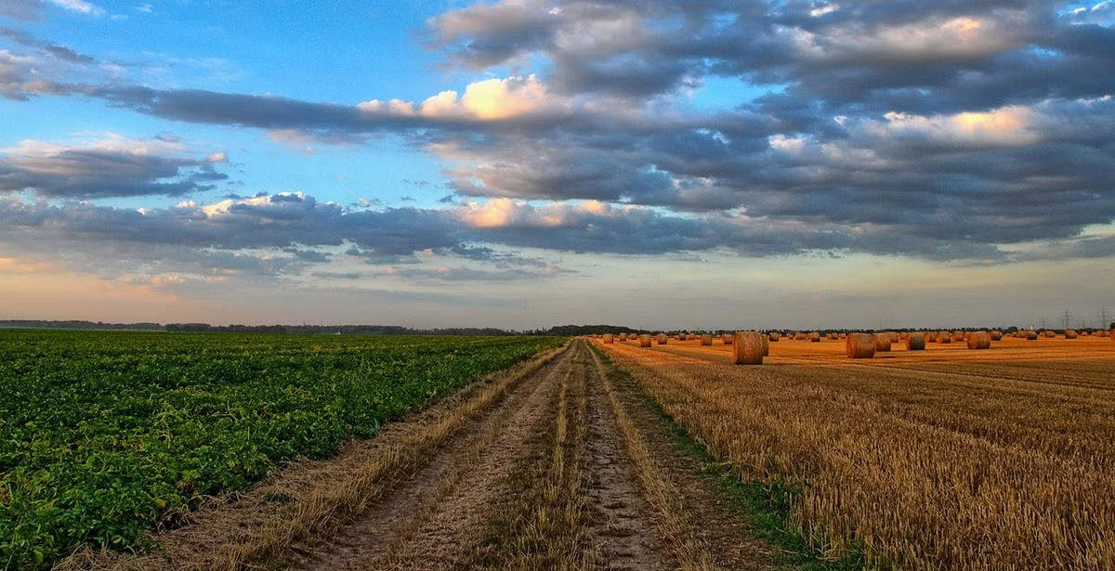

The Challenge: A Global Crisis
1
Crop Losses
2
Weather Variability
Approximately 30-40% of crops are lost annually to diseases, pests, and adverse weather conditions, amounting to an estimated $220 billion in losses worldwide yearly.
With climate change, 90% of agricultural production in developing countries is highly sensitive to climate variability.
3
Market Information Gap
4
Growing Food Demand
A staggering 67% of farmers lack access to real-time market prices, leading to decisions that can result in financial losses.
The global population is projected to reach 9.7 billion by 2050, necessitating a 70% increase in food production.

Slide 3
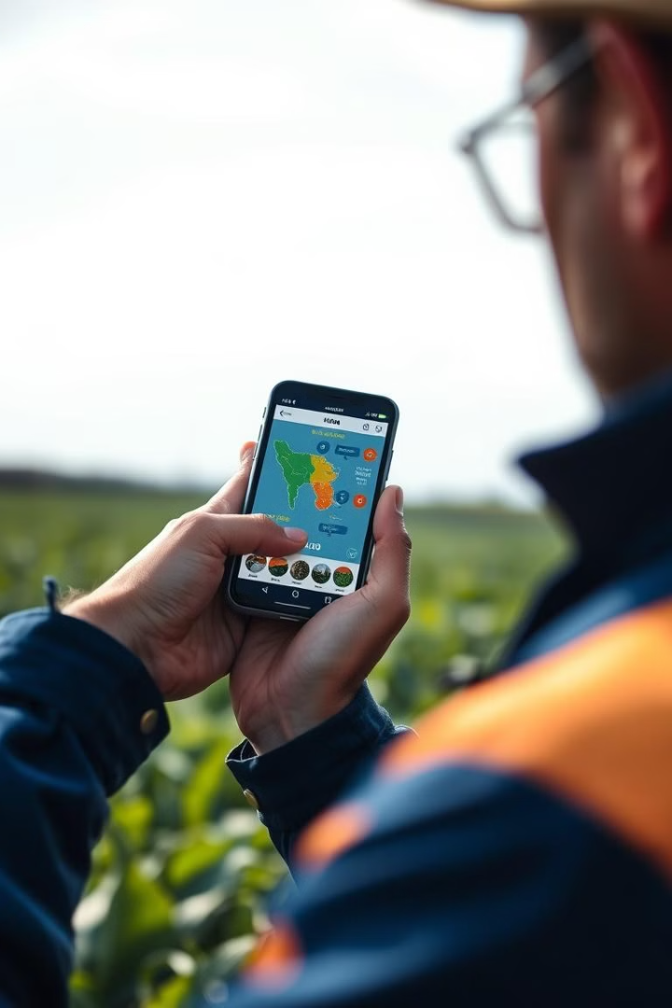
Unique Selling Proposition (USP)
Real-time Insights
Our app provides farmers with real-time data on weather, market prices, and crop health, empowering them to make informed decisions.
Personalized Recommendations
AI-driven, hyper-local farming insights with personalized recommendations help farmers optimize their practices.
Offline Support
The app works even in regions with poor internet connectivity, ensuring farmers have access to critical information.
Farming Community and market place
A place where like minded farmers communicate with each other

Slide 4





TECHNOLOGY STACK
Hardware
Software
ESP32 and DHT22 sensors for data collection.
Frontend in React Native; backend using MongoDB.
AI/ML
Chatbot
TensorFlow
Convolutional Neural Networks.
Time Series Analysis
Integrated for instant support and user engagement.

Slide 5

Profitability Strategies
Freemium Model
Data Monetization
Basic features free; premium features through subscription.
Anonymized insights sold to agribusinesses and research.
Advertisements
Collaborate with suppliers for targeted ads and discounts.
Commission through third parties.

Slide 6
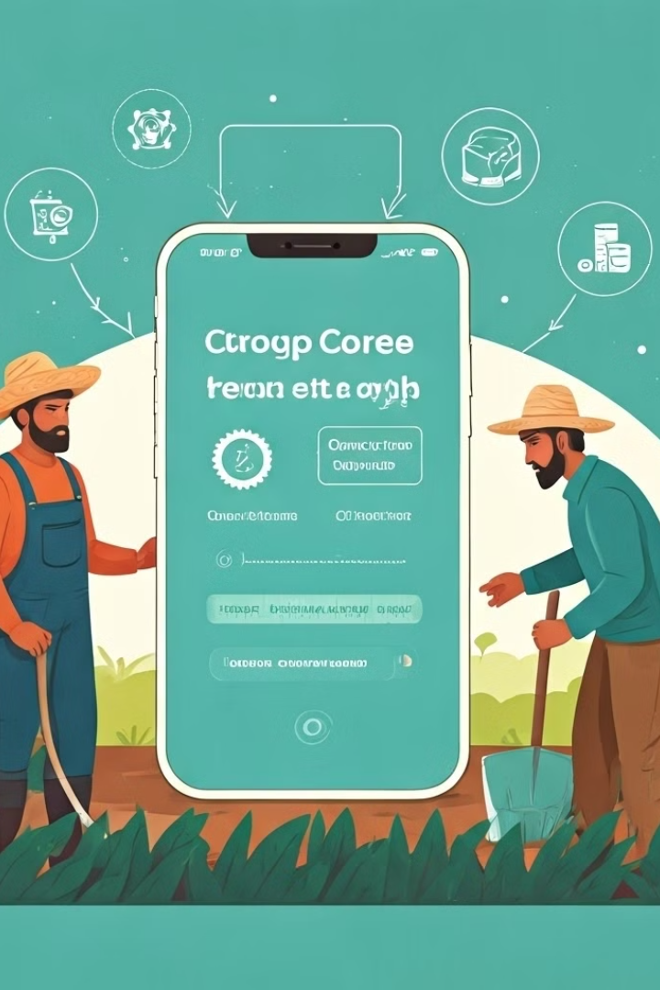
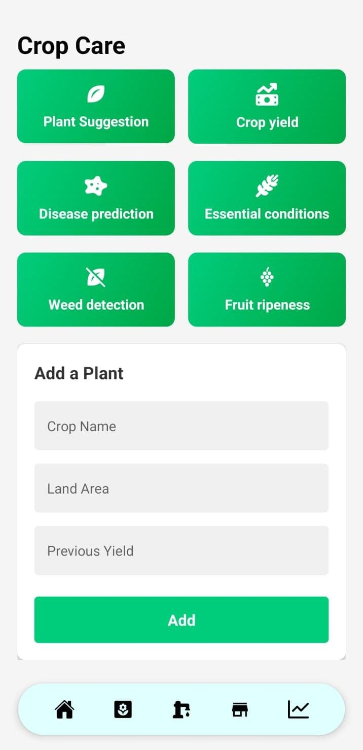



User Engagement and Outreach
Mobile Accessibility
Mobile-friendly design with local language support.
Referral Program
Rewards for bringing in new users, promoting growth.
Farmer Ambassadors
Successful users act as local champions, enhancing trust.

Slide 7
Team Details
Team Lead: Prannavakhanth
Email: prannavakhanth.2023@vitstudent.ac.in Phone: 8072212612
Member 2: K.Hariprasaadh
Email: hariprasaadh.k2023@vitstudent.ac.in
Phone: 9342856540
Member 3: Venkata krishnan G
Email: venkat24092005@gmail.com
Phone: 9940332309
Member 4 : Lohita Lakshmi L.S
Email: Lohitalakshmi.ls2023@vitstudent.ac.in
Phone: 6380431564
Member 5 : Kalyan Sudarsan
Email: kalyan.sudarsan2023@vitstudent.ac.in
Phone: 9094010117
Member 6 : Mithil Girish
Email: mithil.girish2023@vitstudent.ac.in
Phone: 6382320674

